Slide 1
Linear Equations in Linear Algebra
SOLUTION SETS OF LINEAR SYSTEMS

Slide 2





HOMOGENEOUS LINEAR SYSTEMS
A system of linear equations is said to be homogeneous if it can be written in the form , where A is an matrix and 0 is the zero vector in
.
Such a system always has at least one solution, namely, (the zero vector in ).
This zero solution is usually called the trivial solution.
The homogeneous equation has a nontrivial solution if and only if the equation has at least one free variable.

Slide 3
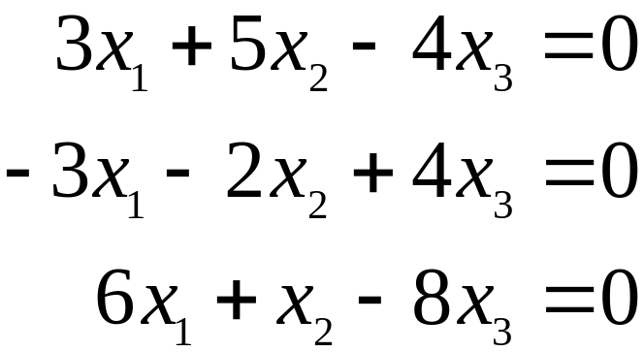
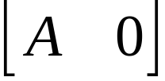
HOMOGENEOUS LINEAR SYSTEMS
Example 1: Determine if the following homogeneous system has a nontrivial solution. Then describe the solution set.
Solution: Let A be the matrix of coefficients of the system and row reduce the augmented matrix to echelon form:

Slide 4
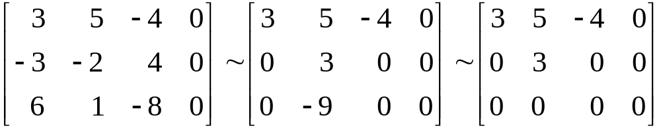


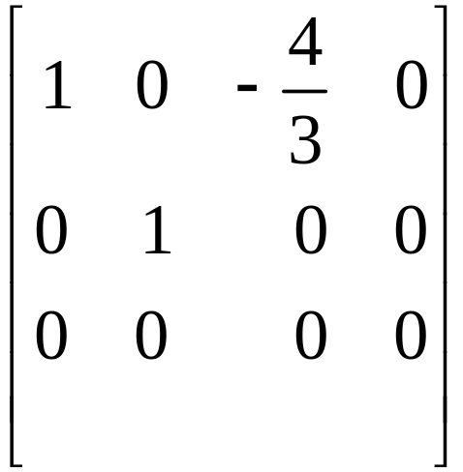
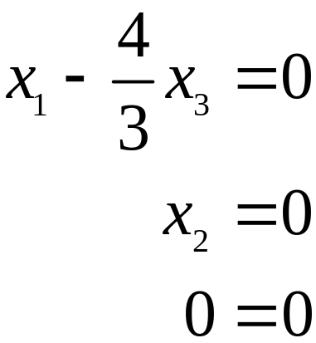
HOMOGENEOUS LINEAR SYSTEMS
Since x₃ is a free variable, has nontrivial solutions (one for each choice of x₃.)
Continue the row reduction of to reduced echelon form:

Slide 5
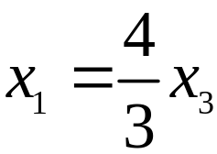

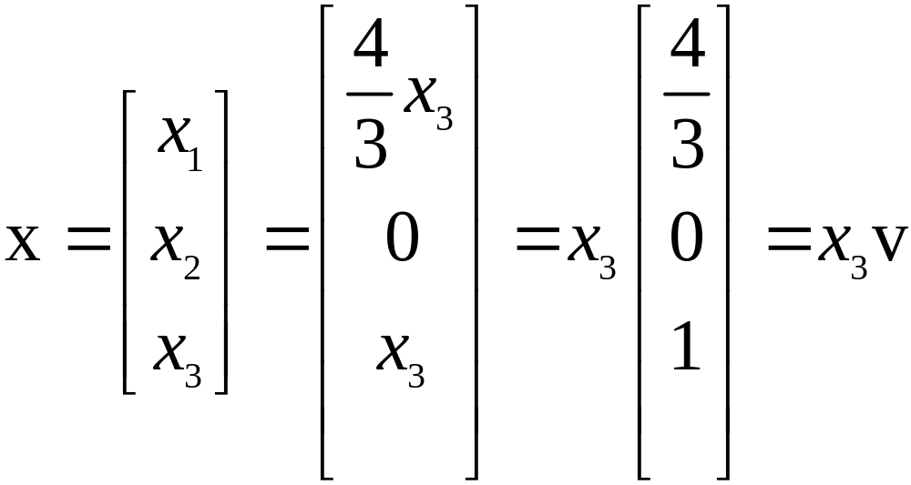
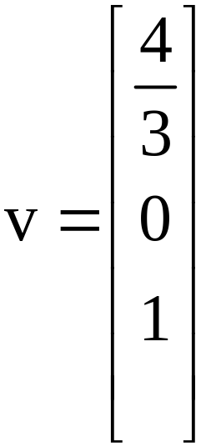
HOMOGENEOUS LINEAR SYSTEMS
Solve for the basic variables x₁ and x₂ to obtain ,
, with x₃ free.
As a vector, the general solution of has the form given below.
, where

Slide 6


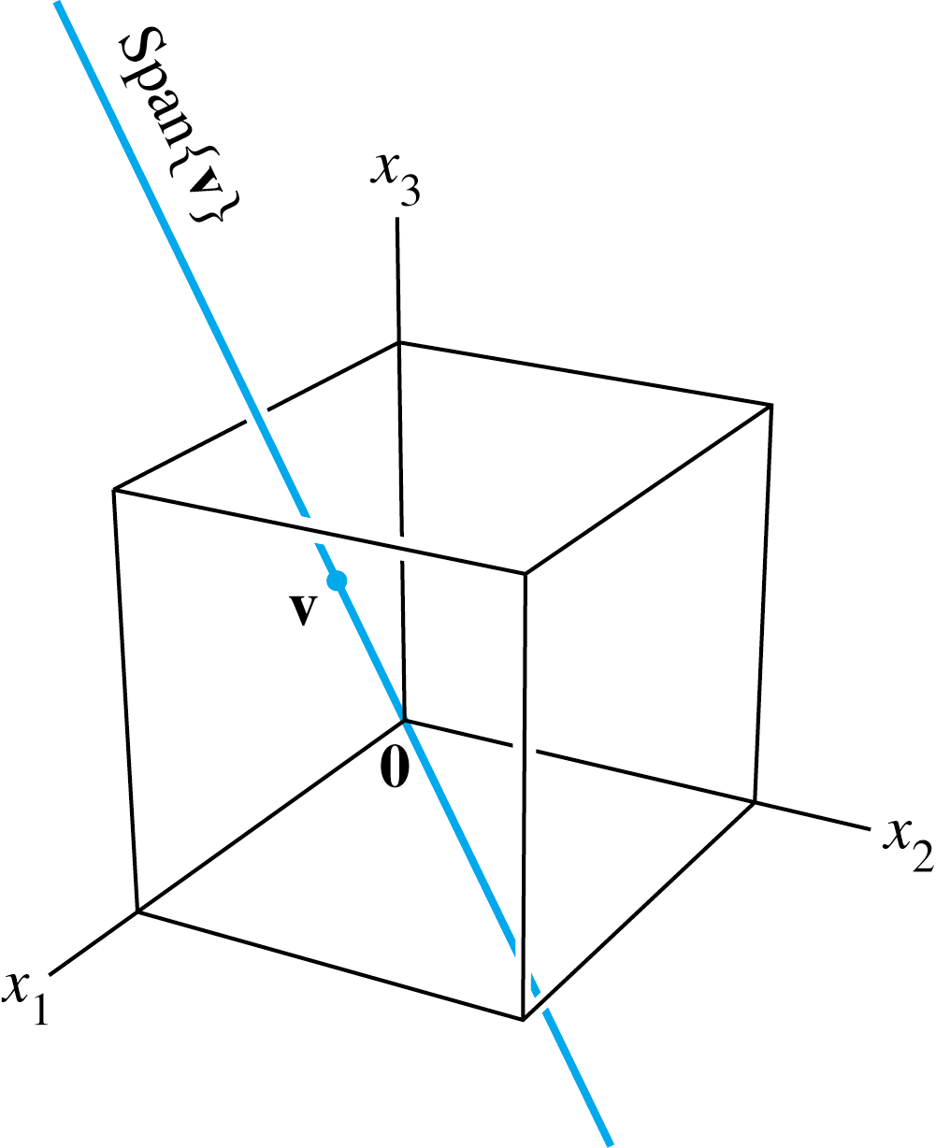
HOMOGENEOUS LINEAR SYSTEMS
Here x₃ is factored out of the expression for the general solution vector.
This shows that every solution of in this case is a scalar multiple of v.
The trivial solution is obtained by choosing .
Geometrically, the solution set is a line through 0 in .
See the figure below.

Slide 7




PARAMETRIC VECTOR FORM
The equation of the form (s, t in ) is called a parametric vector equation of the plane.
In Example 1, the equation (with x₃ free), or
(with t in ), is a parametric vector equation of a line.
Whenever a solution set is described explicitly with vectors as in Example 1, we say that the solution is in parametric vector form.

Slide 8

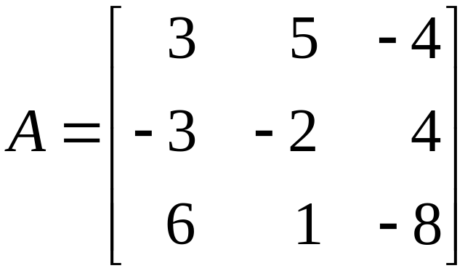
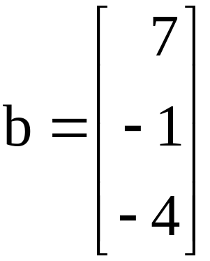
SOLUTIONS OF NONHOMOGENEOUS SYSTEMS
When a nonhomogeneous linear system has many solutions, the general solution can be written in parametric vector form as one vector plus an arbitrary linear combination of vectors that satisfy the corresponding homogeneous system.
Example 2: Describe all solutions of , where
and .

Slide 9
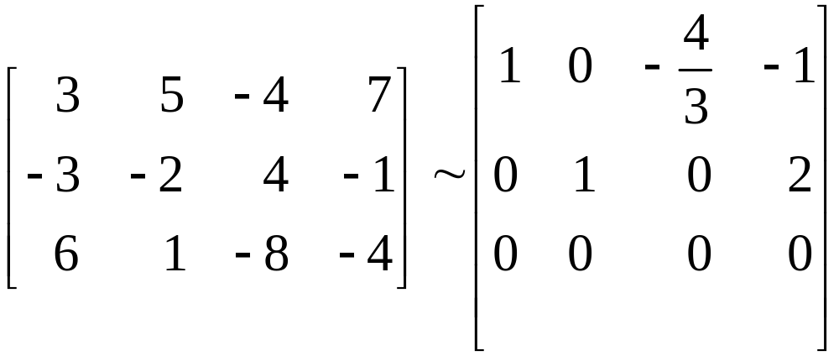
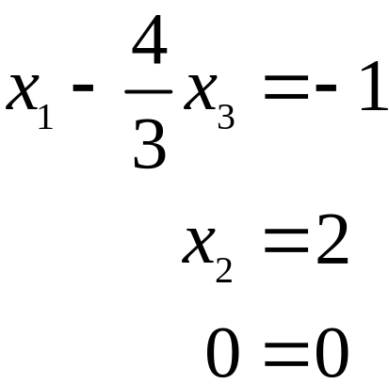
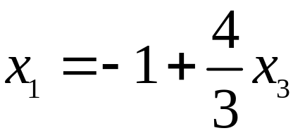

SOLUTIONS OF NONHOMOGENEOUS SYSTEMS
Solution: Row operations on produce
, .
Thus , , and x₃ is free.

Slide 10
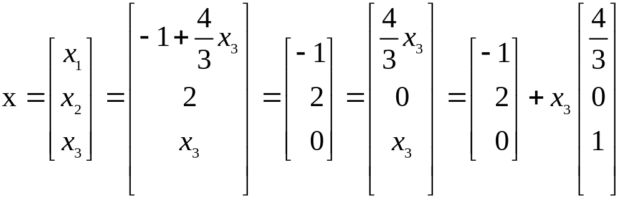
SOLUTIONS OF NONHOMOGENEOUS SYSTEMS
As a vector, the general solution of has the form given below.
p
v

Slide 11




SOLUTIONS OF NONHOMOGENEOUS SYSTEMS
The equation , or, writing t as a general parameter,
(t in ) ----(1)
describes the solution set of in parametric vector form.
The solution set of has the parametric vector equation
(t in ) ----(2)
[with the same v that appears in (1)].
Thus the solutions of are obtained by adding the vector p to the solutions of .

Slide 12




SOLUTIONS OF NONHOMOGENEOUS SYSTEMS
The vector p itself is just one particular solution of
[corresponding to in (1).]
Now, to describe the solution of geometrically, we can think of vector addition as a translation.
Given v and p in or , the effect of adding p to v is to move v in a direction parallel to the line through p and 0.

Slide 13

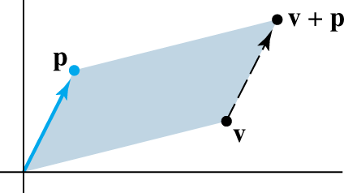
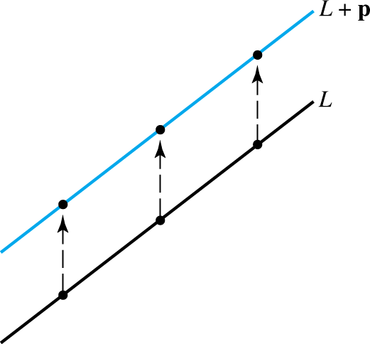
SOLUTIONS OF NONHOMOGENEOUS SYSTEMS
We say that v is translated by p to . See the following figure.
If each point on a line L in or is translated by a vector p, the result is a line parallel to L. See the following figure.

Slide 14
SOLUTIONS OF NONHOMOGENEOUS SYSTEMS
Suppose L is the line through 0 and v, described by equation (2).
Adding p to each point on L produces the translated line described by equation (1).
We call (1) the equation of the line through p parallel to v.
Thus the solution set of is a line through p parallel to the solution set of . The figure on the next slide illustrates this case.

Slide 15
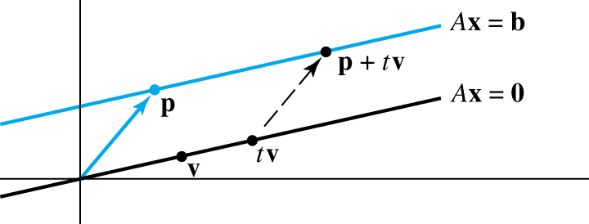


SOLUTIONS OF NONHOMOGENEOUS SYSTEMS
The relation between the solution sets of and shown in the figure above generalizes to any consistent equation , although the solution set will be larger than a line when there are several free variables.

Slide 16

SOLUTIONS OF NONHOMOGENEOUS SYSTEMS
Theorem 6: Suppose the equation is consistent for some given b, and let p be a solution. Then the solution set of is the set of all vectors of the form , where v_{h} is any solution of the homogeneous equation .
This theorem says that if has a solution, then the solution set is obtained by translating the solution set of , using any particular solution p of
for the translation.

Slide 17
WRITING A SOLUTION SET (OF A CONSISTENT SYSTEM) IN PARAMETRIC VECTOR FORM
Row reduce the augmented matrix to reduced echelon form.
Express each basic variable in terms of any free variables appearing in an equation.
Write a typical solution x as a vector whose entries depend on the free variables, if any.
Decompose x into a linear combination of vectors (with numeric entries) using the free variables as parameters.

